Slide 1
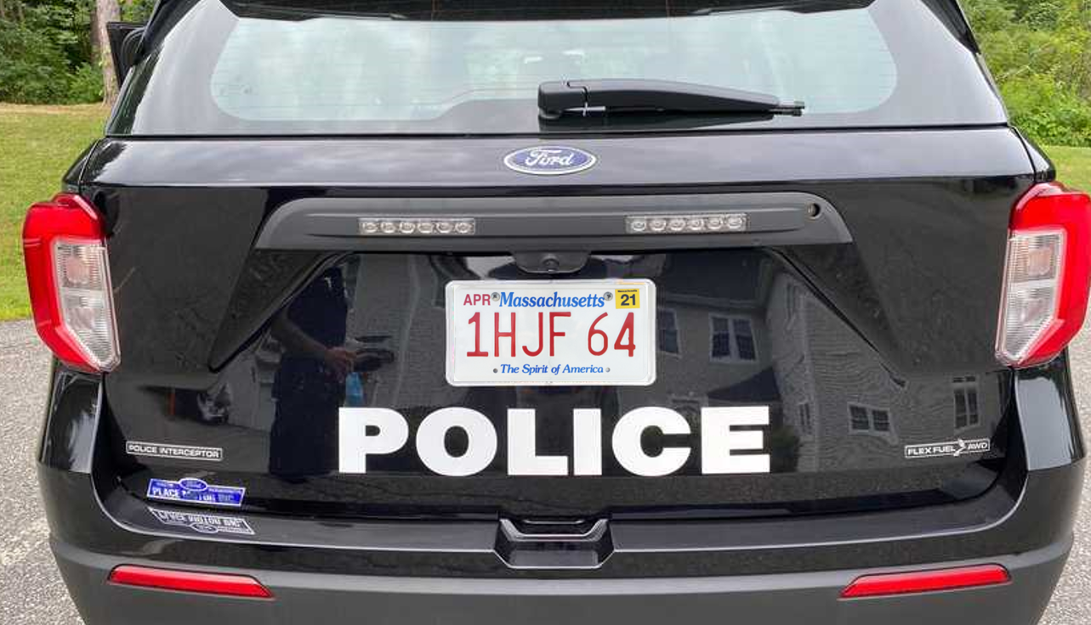
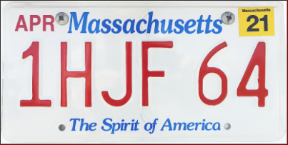



Rectangle
detection
candidates
Size/Shape Filter
PVN
Plate Validation Net
Extract top and bottom parts
- Grayscale
- Edge detection - Binarization
1 H J F 6 4
CRN
Char Recognition Net
Character segmentation
Sequence extraction
RGB/HSV Info
MA
SRN
State Recognition Net

